Slide 1

Charger distribution for
electric vehicles in Munich
Presented by :
Georg Ammer
Thomas Loesekann
Janis Kropp

Slide 2
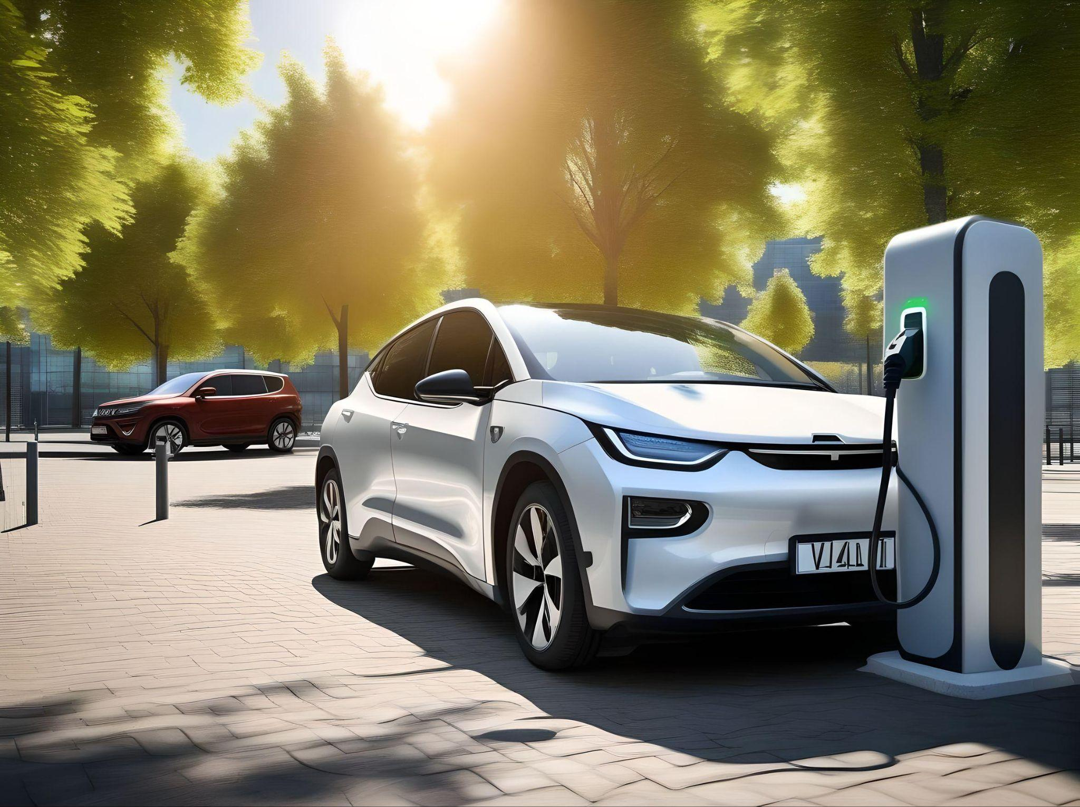
Objective
How many chargers are available
Where are the chargers located
What is the need for the future

Slide 3
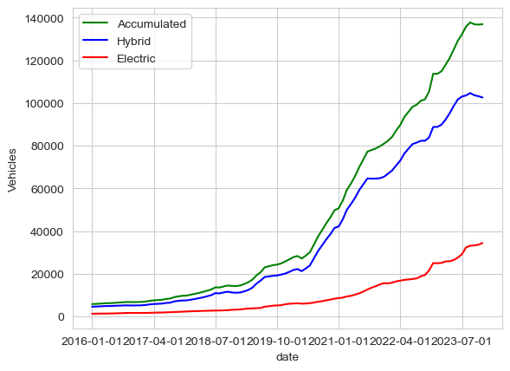
Situation
Electrical cars
In Munich :
34371 electric
102116 hybrid
136967 overall

Slide 4
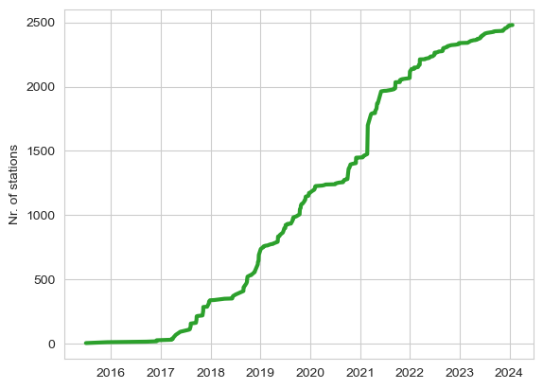
Charging stations
Installed charger
until today : 2414

Slide 5
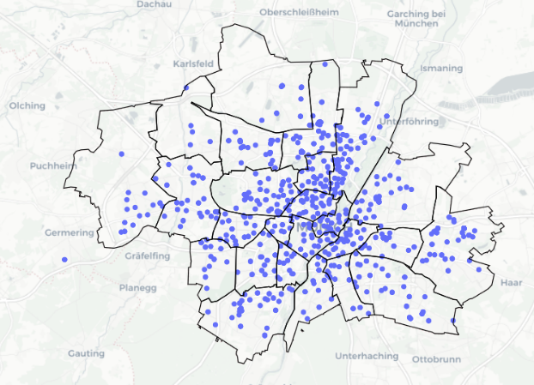
Munich charger locations
Munich is divided
in 25 districts with
10 to 662 chargers per district

Slide 6
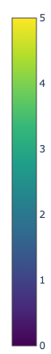
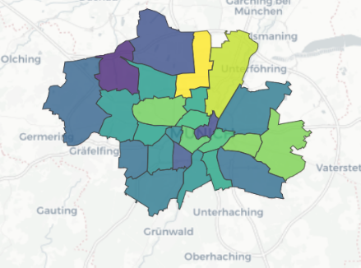
Charger density per car and district
Charger density is very unequal across districts
(up to 30-fold difference!)
chargers per 1000 total cars

Slide 7
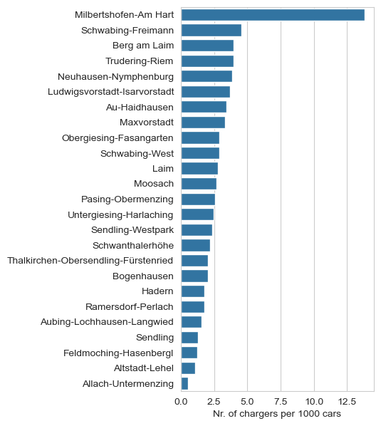
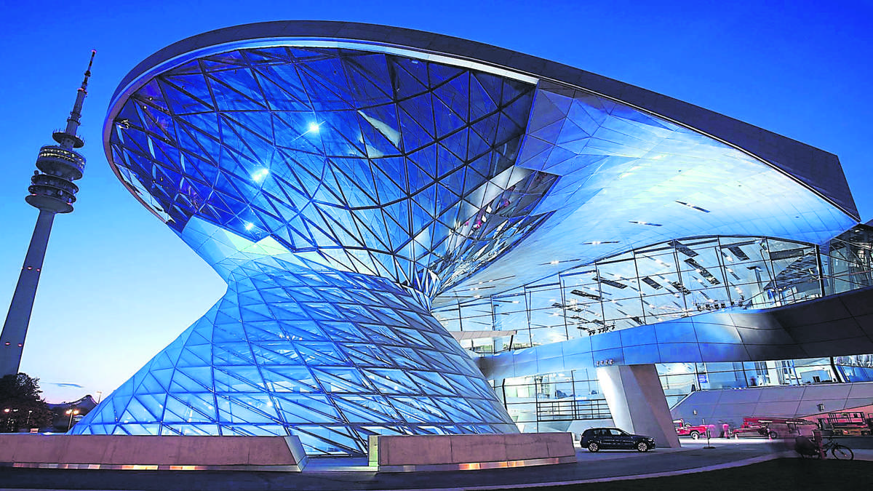
Details of chargers per district
BMW

Slide 8
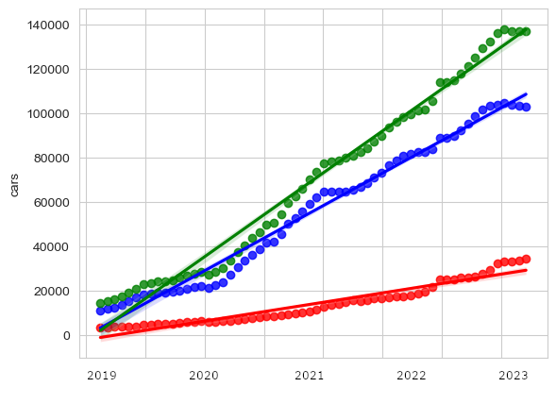
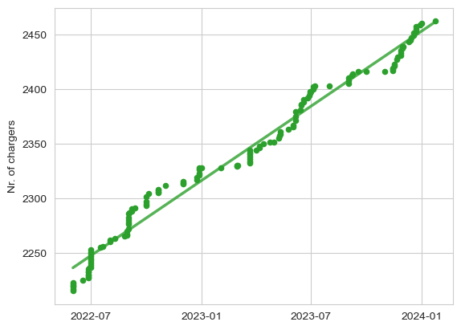
Cars and chargers: regression and prediction
Electric, hybrid and E+hybrid cars
Charging stations

Slide 9
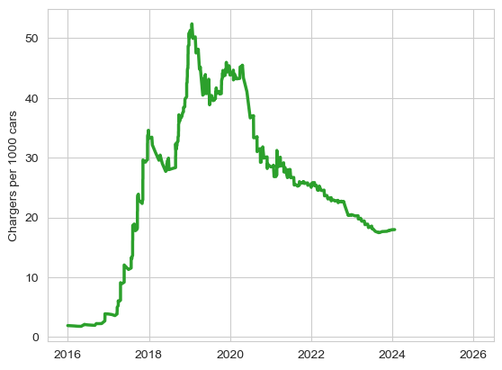
Less and less chargers per car since 2020!
Chargers per car over time
Charger density is sharply decreasing since 2020…

Slide 11
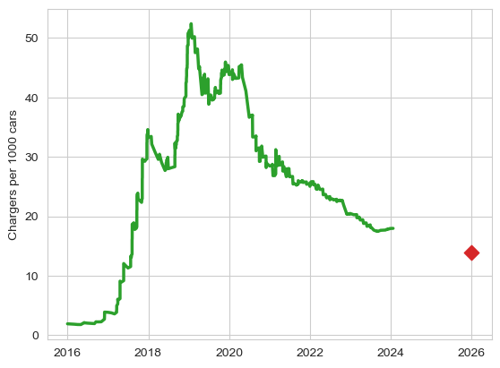
…and even less chargers per car in near future!
Chargers per car over time
Prediction for 2026
(20% decline)
…and will continue to decrease in the future!

Slide 12
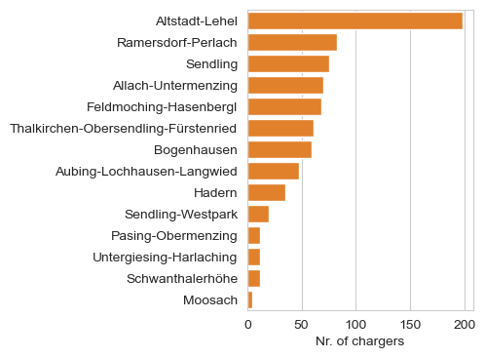
Where to build new chargers and how many???
Demand of new chargers per district
To keep the status quo, at least 759 new chargers have to be built in the next 2 years!

Slide 13
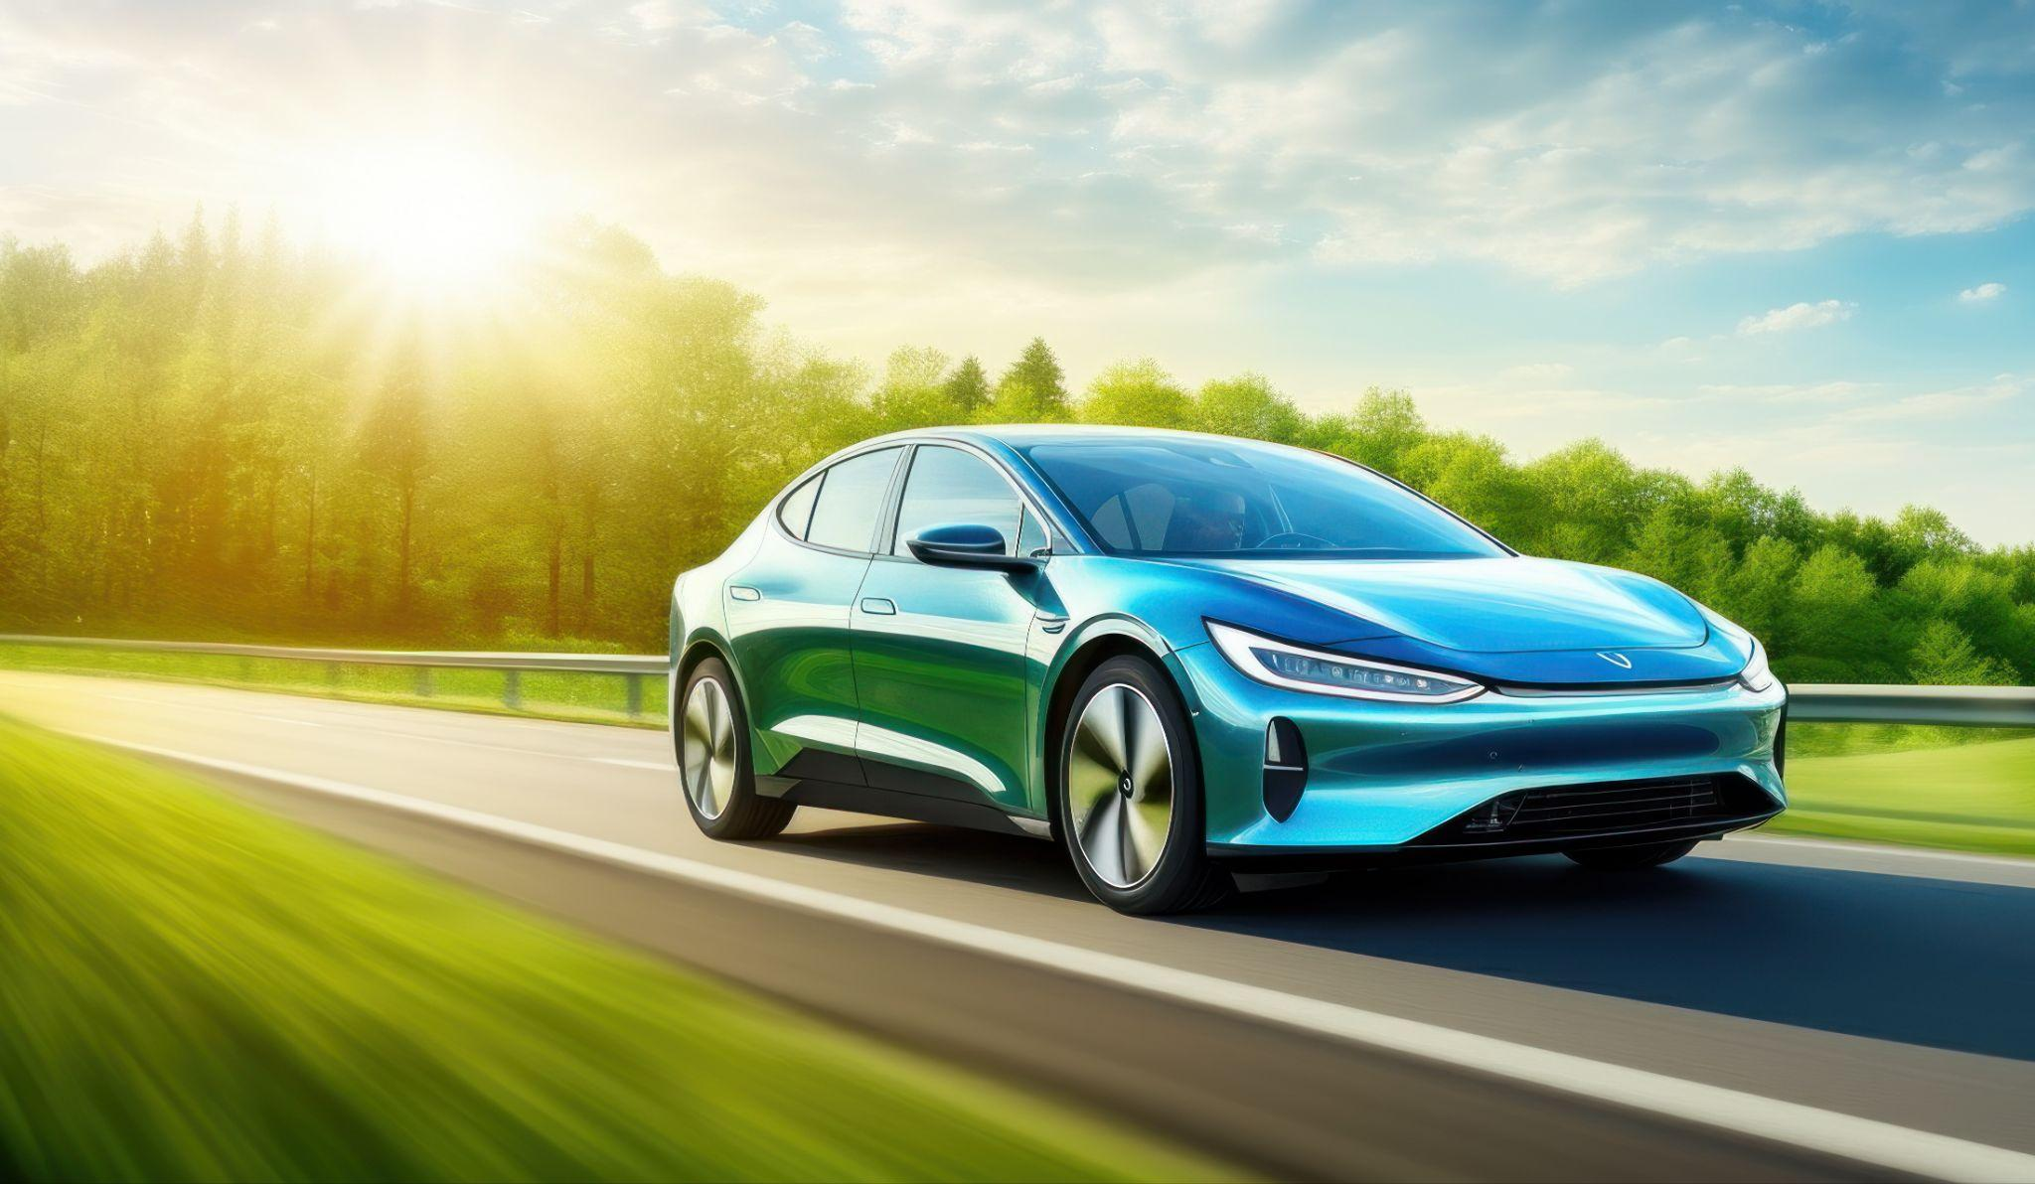
Thank you for your attention!!
Data sources: Open Data Munich, Bundesnetzagentur, Wikipedia

